Slide 1
How can we increase revenue
from
Catch the Pink Flamingo?
Bowen Liu

Slide 2
Problem Statement
Eglence Inc. provides player log files of a popular mobile game called “Catch The Pink Flamingo”. The project aims to find out potential growth point to increase the revenue from game players by analyzing these log files.
Data soucre:
Operation data of game activity
Social network of game players
Notes:
Fill in appropriate/key data set descriptions.
In your script, be sure to make clear how this is a data science story. State in your own words YOUR opinion of why the different kinds and sources of data are so important for Eglence to be able to identify new revenue opportunities.
Operation data of game activity
Operation data could help find out where the past purchase happened, when it happened, and who did the purchase. It is the first step to understand our customers and how is the business model working. Based on that, we could evaluate and design our game scheme, promotion and price strategy in a reasonable way.
Social network of game players
Social network is particularly worthy when we want to develop and promote our game in a more efficient way in the future. Targeting the influential players and groups rather than comprehensive campaign is both effective and efficient.

Slide 3
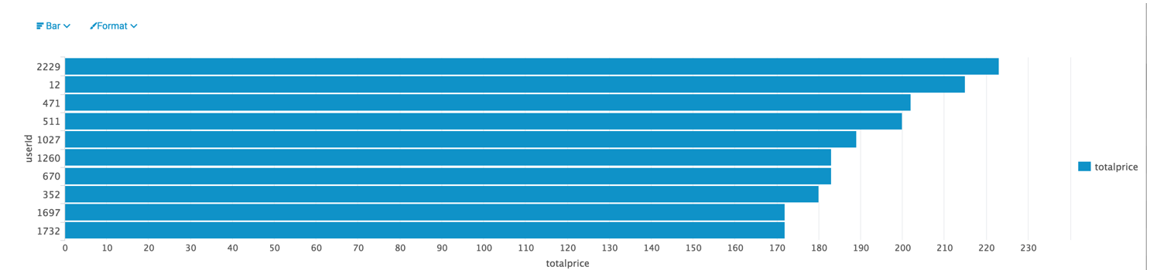
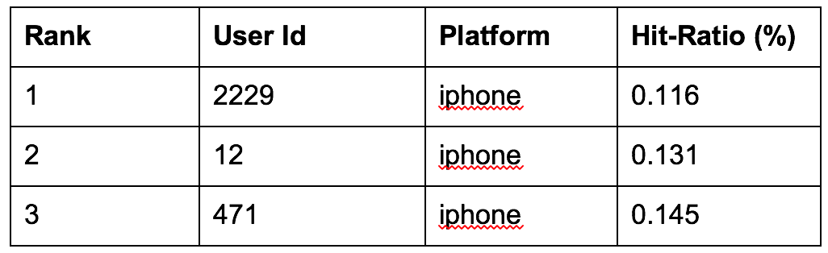
Data Exploration Overview
Top 10 Users who buy most
Platform and Hit-Ration of Top 3 users
Notes:
Assuming you have <2 minutes for this slide, what is the most important thing(s) to convey from your experience with exploring the data?
Top buyers tend to use iPhone most
Top buyers are not top in hit-ratio, which means best players don’t buy most

Slide 4
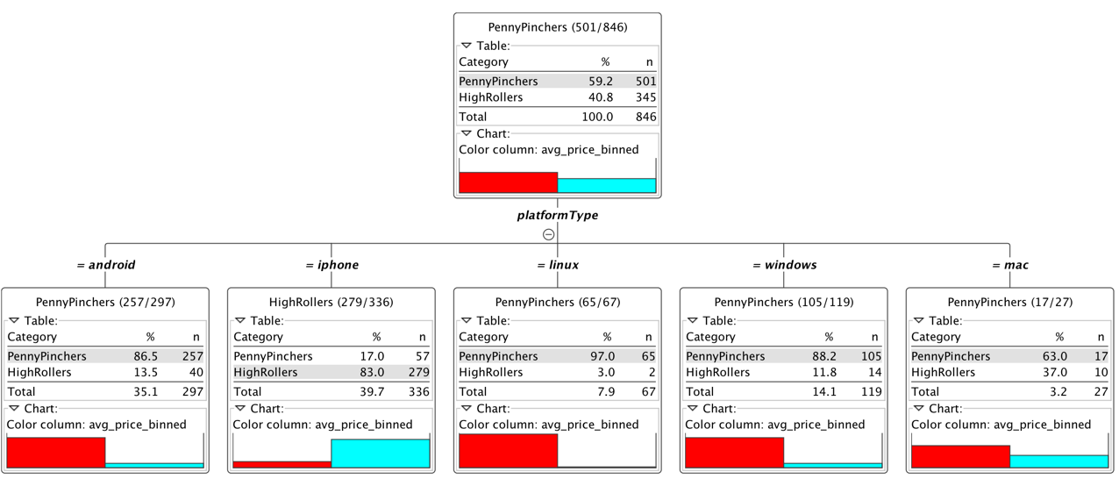
What have we learned from classification?
Notes:
Assume you have 2 minutes to present what you perceive to be the most important or remarkable points from your classification analysis.
HighRoller vs. a PennyPincher?
1. The platformType makes the type of buyer type, and mobile platforms contributes more than PC platforms.
2. In mobile platform, iphone players are more likely to be HighRoller(83%), while android players tend to be PennyPinchers(86.5%)
3. In PC platform, players are generally PennyPinchers, but part of mac users are HighRollers(37%).
What we learned from this classification to increase revenue?
1. Android and Windows are two big user group to develop more HighRollers.
2. Considering the potential HighRoller group in mac platform, it’s worth investing to attract more players from mac platform.

Slide 5
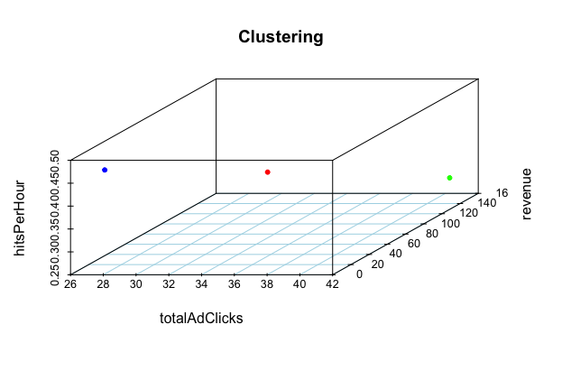
What have we learned from clustering?
totalAdClicks: Ad clicks relate to the revenue that brings profit to the company
totalRevenue: Revenue show the purchase power of users
hitsPerHour: Hits reflect the performance of plays that might affect the purchase activities
Notes:
Assume you have 2 minutes to present what you perceive to be the most important or remarkable points from your classification analysis.
Limit easy level games to advanced players
Since players with highest hitsPerHour dislike to purchase and click ads, the game difficulty could increase gradually for advanced players to reduce their hit rates.
Target ads to plyers with lower hit rates
Lowest hitsPerhour comes with the hightest totalAdClicks and revenue, player groups with lower rates tend to purchase more.

Slide 6
From our chat graph analysis, what further exploration should we undertake?
Find out the most active teams
Relationship between active users and teams
How many relationships are built along with the timestamp
Notes:
Assume you have 2 minutes to present what you perceive to be the most important or remarkable points from your graph analysis
Find out the most active teams
After having the most active users, active teams could also provide important information.
Relationship between active users and teams
Find out if there are some relationship between active teams and users
How many relationships are built along with the timestamp
The frequency of the same type relationships could suggest activity types of users.

Slide 7
Recommendation
For game operation:
Android and Windows are two big user group to develop more HighRollers.
Considering the potential HighRoller group in mac platform, it’s worth investing to attract more players from mac platform.
For game network:
Limit easy level games to advanced players
Target ads to plyers with lower hit rates

